Slide 1
Database Design and Development
Topic 2:
Enhancing Design (1)
Notes:
NCC Education - Title Master

Slide 2
Scope and Coverage
This topic will cover:
  Introduction to normalisation
  The concept of functional dependency
  Data redundancy and update anomalies
  Overcoming anomalies with normalisation
Notes:
NCC Education - Slide Master

Slide 3
Learning Outcomes
By the end of this topic students will be able to:
  Explain the reason why the process of normalisation is carried out
  Normalise a document to third normal form

Slide 4
Some Key Concepts
  Relational integrity
  Nulls
  Entity integrity
  Referential integrity
  General constraints

Slide 5
Question
  Why cannot any part of a primary key be null?
?

Slide 6
Answer
  Because a null value, being unknown, might be the same as the value in the primary key of another tuple.

Slide 7
Properties of a Relation
  Relation Named
  Atomic values in cells
  Attribute Named
  Attribute value drawn from a domain
  No duplicate tuples (rows)
  No significance to order of tuples
  No significance to order of attributes

Slide 8
Functional Dependence - 1
  A → B
  This is the notation
  If we know the value of A then we will know the value of B

Slide 9
Functional Dependence - 2
  StudentID → StudentName
StudentID | StudentName
23 | Singh
34 | Smith
56 | Smith
76 | Singh

Slide 10
Super-keys, Candidate Keys, Primary Keys - 1
StudentID | Activity | Cost
21 | Dancing | $23
21 | Swimming | $50
34 | Dancing | $23
55 | Fencing | $20

Slide 11
Super-keys, Candidate Keys, Primary Keys - 2
StudentID | Activity | Cost
21 | Dancing | $23
21 | Swimming | $50
34 | Dancing | $23
55 | Fencing | $20
Activity → Cost
No other dependencies
Would need all the attributes to be a primary key

Slide 12
Deletion and Update Anomolies
What happens if we change the price of Dancing?
StudentID | Activity | Cost
21 | Dancing | $23
21 | Swimming | $50
34 | Dancing | $23
55 | Fencing | $20
What happens if we delete this row?

Slide 13
Splitting the Relation
StudentID | Activity | Cost
21 | Dancing | $23
21 | Swimming | $50
34 | Dancing | $23
55 | Fencing | $20
StudentID | Activity
21 | Dancing
21 | Swimming
34 | Dancing
55 | Fencing
Activity | Cost
Dancing | $23
Swimming | $50
Fencing | $20

Slide 14
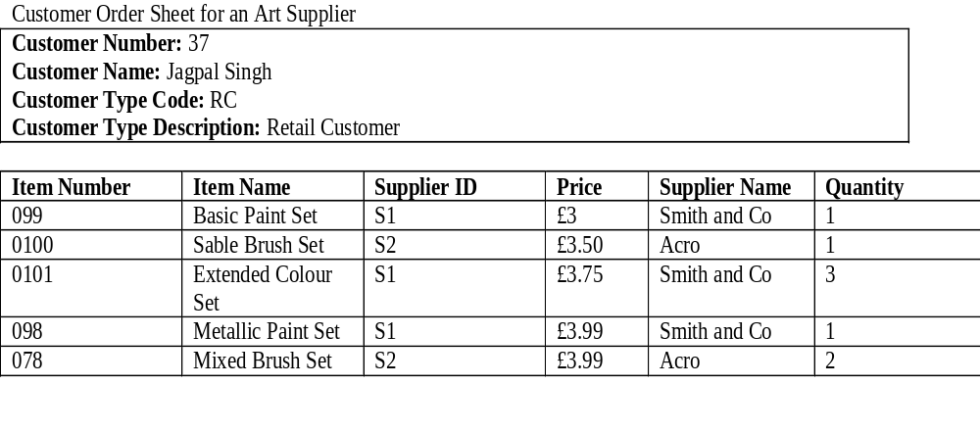
Customer Order Sheet for Art Supply Shop

Slide 15
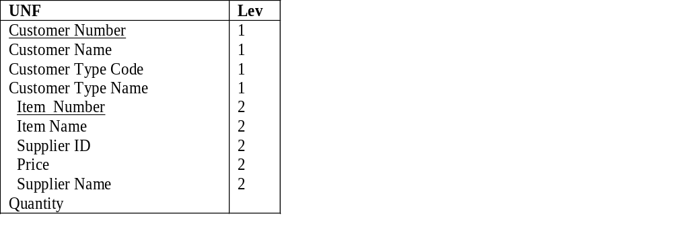
First Step
Un-normalised Form. Identify repeating groups

Slide 16
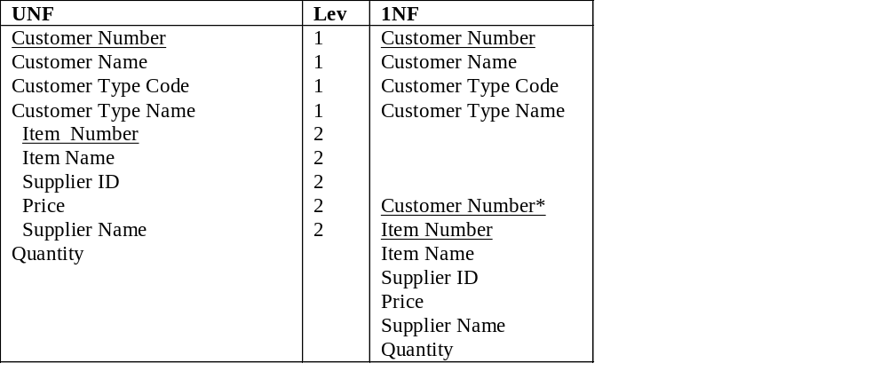
First Normal Form (1NF)

Slide 17
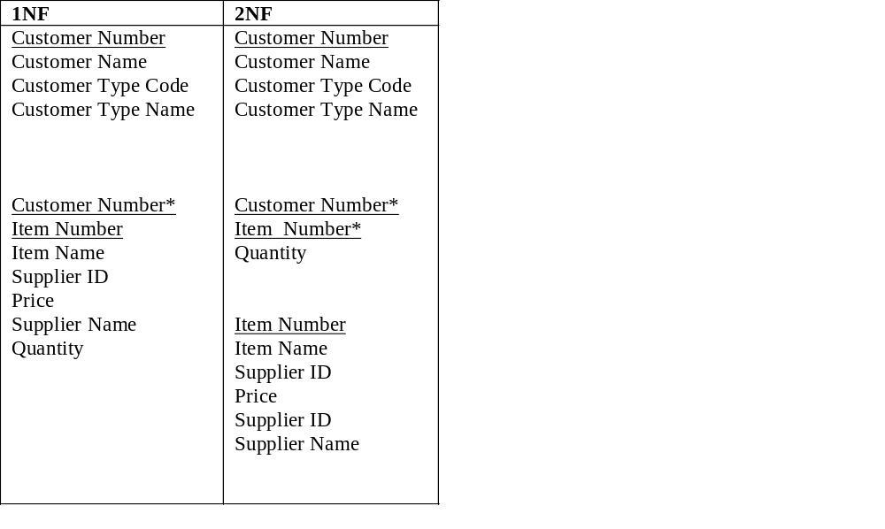
Second Normal Form (2NF)

Slide 18
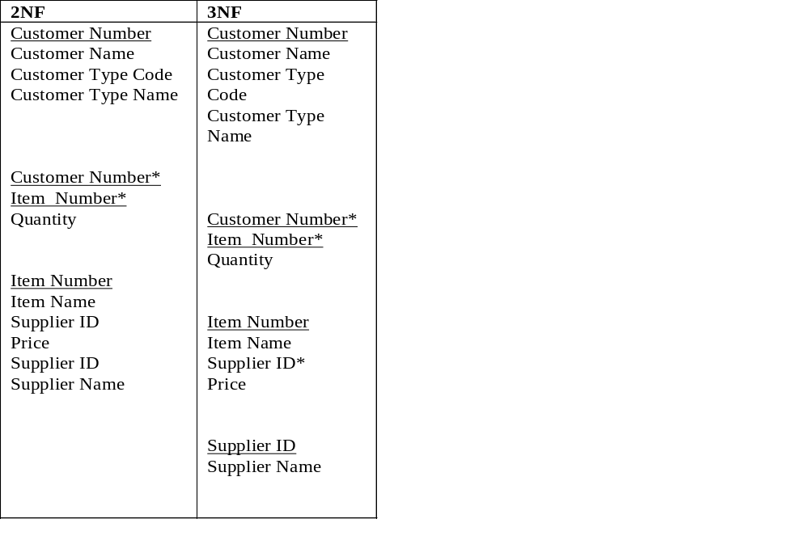
Third Normal Form (3NF)

Slide 19
Third Normal Form (3NF) to Deriving Entities
Customer
CustomerItem
Item
Supplier

Slide 20
The Entity Relationship Diagram
Customer
1
0...*
CustomerItem
0...*
1
Item
0...*
1
Supplier

Slide 21
Normalisation and Semantics - 1
  Normalisation depends on understanding the meaning of the data.
  For example the price of an item depends on just the item. If the same item could be supplied by different suppliers at different prices then the normalisation would look different. How?

Slide 22
Normalisation and Semantics - 2
  Answer: there would be a separate group of attributes with the primary key of Supplier Number and Item Number. Price would be functionally dependent on both of these attributes and would therefore be an attribute of this entity.

Slide 23
Extended Example
  To be used throughout the course
  Lots of different documents might be examined e.g.
    Customer records
    Sales sheets
    Receipts and invoices

Slide 24
Marlowe Interiors - 1
Interior Designer
Two Brothers
Makeovers
Index cards for customer records
Box file with paper invoices

Slide 25
Marlowe Interiors - 2
Marlowe Interiors
1 Newington Green Road
London
N1 TYY
020 7888 1234
Job: Kitchen Makeover
Customer: Ivan Jones, 2 Digby Mansions. Highbury Park
Area: London North
Date: 02/03/00
Parts
1 sink, tin @ 130.00 including VAT.
1 u-pipe @ 20.00 ditto
3 x assorted plumbing fittings @ 33.00 total including VAT
1 thermostat @ 100.00 including VAT
Labour
Plumber 3 hours £150
Labourer 3 hours £60
Electrician 1 hour £50 (to fit thermostat)
TOTAL PARTS £283.00 TOTAL LABOUR £260.00
TOTAL £543.00

Slide 26
Job | Customer | Area | Date | Part | Labour
Kitchen Makeover | Ivan Jones, 2 Digby Mansions. Highbury Park | North London | 02/03/00 | 1 sink, tin @ 130.00 | Plumber 3 hours £150
Kitchen Makeover | Ivan Jones, 2 Digby Mansions. Highbury Park | North London | 02/03/00 | 1 u-pipe @ 20.00 | Labourer 3 hours £60
Kitchen Makeover | Ivan Jones, 2 Digby Mansions. Highbury Park | North London | 02/03/00 | 3 x assorted plumbing fittings
Kitchen Makeover | Ivan Jones, 2 Digby Mansions. Highbury Park | North London | 02/03/00 | 1 thermostat @ 100.00 | Electrician 1 hour £50 (to fit thermostat)

Slide 27
Self Study
  You will be asked to normalise this document.

Slide 28
Learning Outcomes
By the end of this unit students will be able to:
  Explain the reason why the process of normalisation is carried out
  Normalise a document to third normal form
Have we met them?

Slide 29
References
  Benyon-Davies, Paul Database Systems Palgrave Third Edition 2004 Chapter 18
  Connolly, Thomas M., and Begg, Carolyn E., Database Systems: A Practical Approach to Design and Implementation Addision-Wesley, Fourth Edition 2005 Chapter 13

Slide 30
Topic 2 – Enhancing Design (1)
Any Questions?
Notes:
NCC Education - End Slide Master

